Slide 1
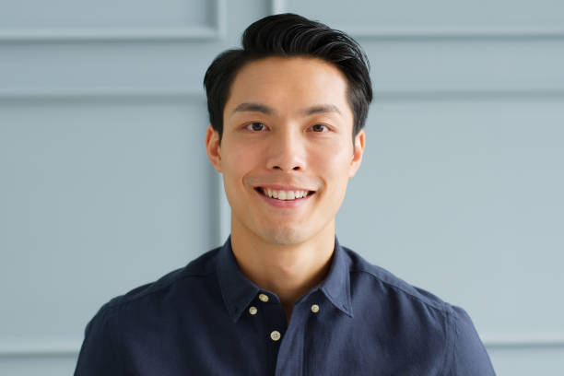
Persona 1
Name: David Kim
Age: 42
Occupation: Construction Project Manager
Education: Bachelor's degree in Civil Engineering
Personality: David is a hard-working and responsible individual who takes pride in his work. He is a detail-oriented person who pays close attention to his surroundings and is always looking for ways to improve processes. He is also health-conscious and enjoys staying active by jogging and playing basketball with his friends.
Interests: David is interested in technology and enjoys exploring new apps and software. He is also an advocate for sun safety and spends a lot of time outdoors due to his job, which has increased his risk of skin cancer. He enjoys learning about new ways to protect his skin and stay healthy.
Goals: David's main goal is to excel in his career and take on larger construction projects. He also wants to continue leading an active and healthy lifestyle, which includes monitoring his skin for signs of skin cancer. He hopes to use technology to help him achieve his health goals and stay informed about the latest developments in sun protection.
Challenges: David faces challenges in balancing his demanding job with his personal life. He also struggles with keeping track of his skin health, as it can be difficult to remember to check his skin for changes regularly. He hopes to use a skin cancer detection app to help him monitor his skin and catch any potential issues early on. However, he is also concerned about the accuracy of such apps and wants to ensure that he is using a reliable and trustworthy tool.

